Slide 1
Real Estate Market Predictions
A look at NC real estate in the wider context of the Eastern United States

Slide 2
Why real estate? Why now?
A world wide pandemic brought about a low supply supply of housing with a high demand. This has been driving drastic price increases. As inflation begins to increase mortgage rates will the housing market continue to see such growth? Will prices level off? Or will the housing market crash as it did between 2008 and 2011?

Slide 3
Data Sources
Datasets are taken from Realtor.com, selected CSVs of interest include:
the RDC Core Metrics by Zipcode Inventory of historical data
The RDC Inventory Hotness Metrics Zip History
zipcode latitude and longitude data sourced from Github repo

Slide 4
Questions we hope to answer:
1. Is the real estate market increasing, leveling off, or crashing?
2 .Is North Carolina real estate in line with the trending data of the rest of United States?
3. Will different geographical regions retain a stronger real estate market due to migration outside of major metro areas as work from home options increase post pandemic?

Slide 5
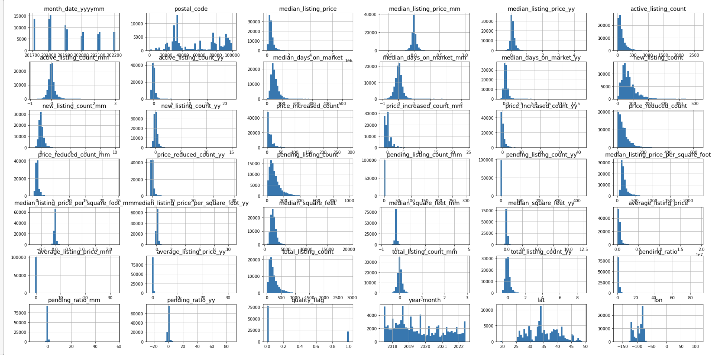
Data Exploration
Utilize pandas to access data types, drop nulls, examine features

Slide 6
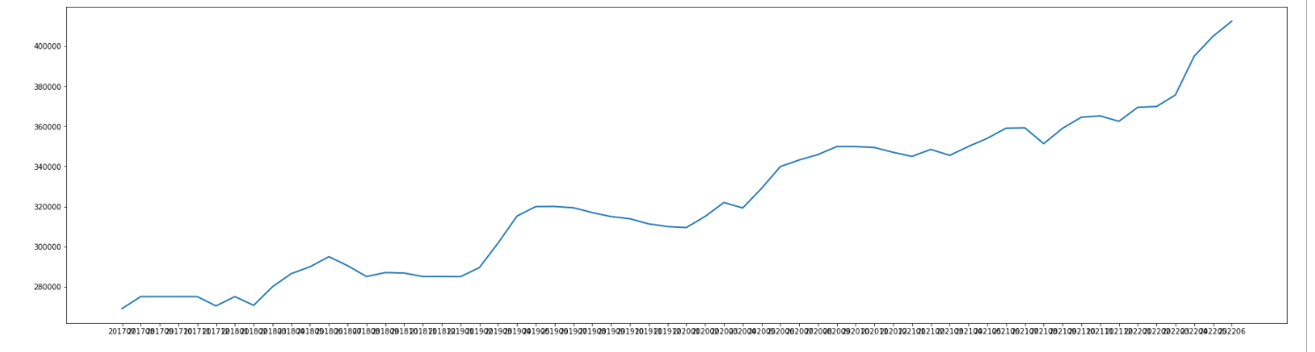
Data Analysis
Data contains too many features to successfully utilize accessible machine learning tools
Zip Code data file containing latitudes and longitudes added to generate more options for graphing and analyzing in Tableau
Increased original data set to include United states rather than only NC
Plotted various features - NC median price 2017 - 06/2020

